Slide 1
Venture capital
student’s name
institution instructor
course
date

Slide 2
The Barringer/Ireland Business Model Template
A model that allows for description, analysis and presenting a venture.
represents the basic elements of business
the model consists of:
  Core stratergy
  resources
  financials
  operations
The aim is to lay visual framework of business and see interrelationship between different components for comparisons

Slide 3

the three venture capitalists firms
Venture capitalist firm- firms that finance business nthat are risky but promising.
Provide start up business and small businesses with capital and financing
the venture capital firms to explore:
  Greycroft
  GGV Capital
  Accell

Slide 4

New Enterprise Association ( NEA) : Core Strategy
Business mission: “ to make world better by helping founders build great companies that improve the way we live, work and play”
Basis of differentiation: product differentiation
Target market: Technology and healthcare sectors
Product/ Market scope: Venture capital funding

Slide 5

New Enterprise Association : Recourses
Core competency:
robust product innovation
market experience
high global expansion
Technological competency
Key Assets: $20.2 billion assets in management
invested in nearly 700 comoanies

Slide 6
New Enterprise Association: Financials
Revenue streams:
  has average annual revenue of $53.67 million
  closed on $3.6 billion fund in 2020
  continued growth of the company brings in more revenue prospects
Cost structure:
  Management percentage annual fee: 1.25%
financing/funding:
  Invests 60% of investments on information technology, and 40% on healthcare
  equity investors
  Investment returns

Slide 7

Operations
product operations: investment insights
innovation financing
Channels: media, commerce, software and systems
key partners:
  Nebraska Investment Council
  Branch Metrics
  Built Robotics
  Cleo
  Goop
  Luminary

Slide 8
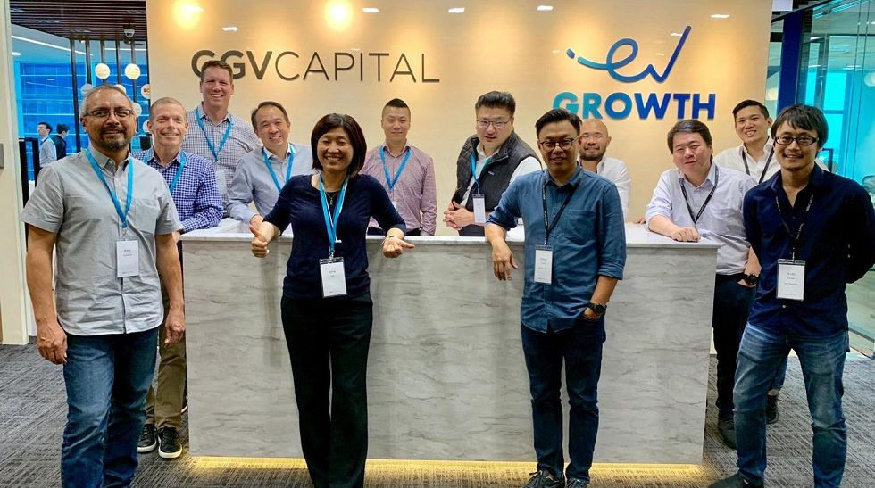
GGV Capital
Mission: “To make financial services global and accessible to everyone”
Basis of differentiation: Price
Target market: Young entrepreneurs
product scope: Different financing products customized to social/internet, enterprise tech and smart tech business.
  Consulting services

Slide 9

GGV Capital Resources
Assets: 9.2 billion
GGV Discovery - $ 610 billion
GGV Capital VIII Entrepreneurship fund-$80
GGV Capital Fund – $525 million
Core competency- technological competency
Product portfolio diversification

Slide 10

GGV Capital Financials
Revenue stream – annual average revenue of $ 67 million
Financing - multiple portfolio companies
2% management fee
9.04% average annual returns on held assets
costs and liabilities- %38 million

Slide 11

GGV Capital operations
products and services- fund investments and busineses/ enterprise financing
key sectors for operations
social/internet
enterprise technology
smart technology
Key partners- Big Commerce, Alibaba, Airbnb, Affirm and JD MRO.

Slide 12

Accel
Accel Inc.: Core Strategy
business Misison- “To partner with outstanding entrepreneurs and management teams in building world class companies, from inception to growth”
Basis of differentiation-geographical differentiation
target market- start ups and early growth companies.

Slide 13

Resources
Key Assets- $8.3 billion in held funds
aggregate of 4 companies in one Accel brand:
Access management Co. –US
Accel London Management limited- London
Accerss Partners Management LLP- London
Core Competency-superior technological adoption

Slide 14

Acces- Financials
Revenue: $32.89 million
1615 investments globally
recent investment June, 30, 2021- $12 million- Detect investment
625 lead investments

Slide 15
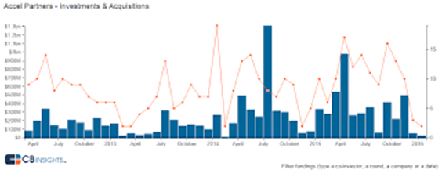
Operations
Handled more than 5 girst purchases
Key Partners:
  Atlassian
  Braintree
  Cloudera
  DJI, Dropbox
  Dropcam
  Etsy
  Facebook
  Flipkart
  Lookout Security
  MoPub

Slide 16

Components of business plan to highlight in seeking capital
Company description- gives the financiers key information regarding the business like location and address, goals, mission and vision.
Market analysis- highlights the target market potential and future prospects , against business potential.
Competitive analysis- for better understanding of competitors and competitiveness
Sales strategy- gives potential for generating revenue

Slide 17
References
Pitchbook. (n.d.). New enterprise associates. Venture Capital, Private Equity and M&A Database | PitchBook. https://pitchbook.com/profiles/investor/11251-81#overview
New Enterprise Associates. (2020, April 6). New enterprise associates. Digest Africa. https://digestafrica.com/investors/new-enterprise-associates
Accel Partners. (2021). Accel. Venture Capital, Private Equity and M&A Database | PitchBook. https://pitchbook.com/profiles/investor/10139-41#overview
Accel Inc. (2021, May 30). Accel. https://www.accel.com/
Loizos C. (2021, January 28). GGV capital just announced $2.52 billion across new funds for ‘entrepreneurs around the world’ – TechCrunch. TechCrunch. /
Capital, G. (2021, January 28). GGV capital raises $2.52 billion to invest in entrepreneurs around the world. PR Newswire: press release distribution, targeting, monitoring and marketing. https://www.prnewswire.com/news-releases/ggv-capital-raises-2-52-billion-to-invest-in-entrepreneurs-around-the-world-301216844.html
Barringer, E., & Ireland, R. D. (2010). Successfully launching new ventures.

